Slide 1
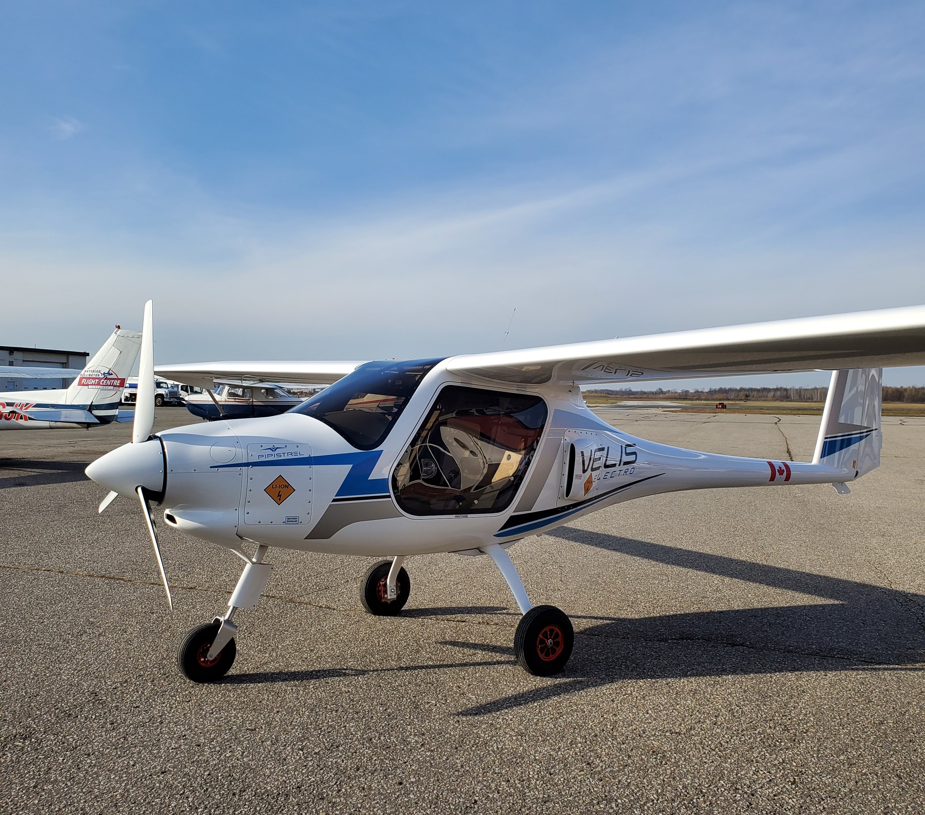
LOGO OF YOUR
AFFILATION
Electric Aviation: The Third Revolution in aviation propulsion
Paul Parker
Associate Director, Environment, WISA, Waterloo Institute for Sustainable Aeronautics
Adjunct Professor, Faculty of Environment, University of Waterloo
pparker@uwaterloo.ca
Kitchener-Waterloo Recreational Aircraft Association, YKF
12 January 2023
Pipistrel Velis Electro
Paul Parker
Notes:
This is your opening joke about hoping to have the eplane on display. Instead it is still in the container, but getting closer.

Slide 2
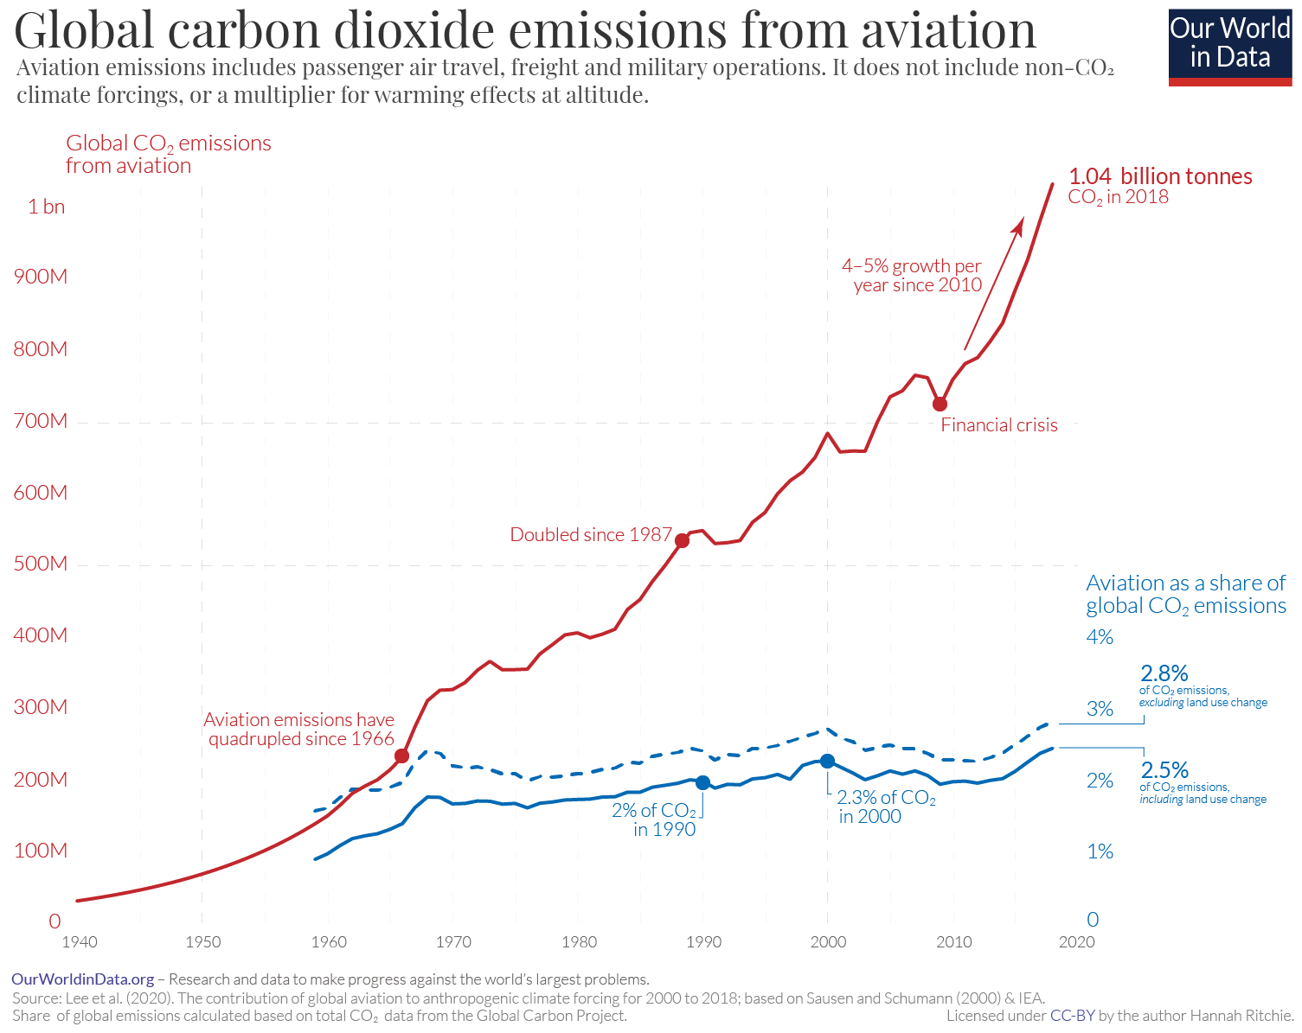
Research Motivation
multiple aviation challenges /crises
Talent shortage
Climate crisis / emissions reduction
New technologies / greater efficiency
Motivations (drivers) must be > Barriers to adoption
Many options need testing
Notes:
Multiple crises, but the rapid increase in emissions and associated impacts demands attention
We recognize motivations and barriers. Motivations need to be bigger to stimulate change. Solutions can combine the need to reduce emissions and attract new talent with new technology.

Slide 5
At Airbus, we see two primary uses for hydrogen:
Hydrogen propulsion: Hydrogen can be combusted through modified gas-turbine engines or converted into electrical power that complements the gas turbine via fuel cells. The combination of both creates a highly efficient hybrid-electric propulsion chain powered entirely by hydrogen.
Synthetic fuels: Hydrogen can be used to create e-fuels, which are generated exclusively through renewable energy. Hydrogen produced using renewable electricity is combined with carbon dioxide to form a carbon fuel with net-zero greenhouse gas emissions.
We expect to make the necessary decisions on the best combination of hydrogen technologies by 2025. (for 2035 commercial use)
https://www.airbus.com/en/newsroom/stories/2022-11-the-cold-heart-that-powers-our-zeroe-aircraft

Slide 6
Airbus and electric aviation
https://www.airbus.com/en/innovation/zero-emission-journey/electric-flight

Slide 7
Harbour Air ePlane
DHC-2 de Havilland Beaver
6 seats, versatile bushplane
2019 first flight (circuit) A-A
2022 Vancouver-Victoria A-B
24 minutes
1947-1967 1600 manufactured
MagniX
all-electric magni500 propulsion system
280 kW at 1900 rpm
https://www.aerospace-technology.com/projects/harbour-air-eplane/

Slide 8
Air Canada ES-30
Heart Aerospace
Swedish start-up
E-30 replaced E19
30 passengers
reserve-hybrid configuration, consisting of two turbo generators (jet fuel), to get 400 km range and the reserve energy requirements
Investors
United /Mesa Airlines, 100 ordered 2021
Breakthrough Energy Ventures (Bill Gates)
Air Canada, 30 ordered 2022
Saab
https://electrek.co/2022/09/16/air-canada-invests-heart-aerospace-orders-updated-versions-electric-airplane/

Slide 9
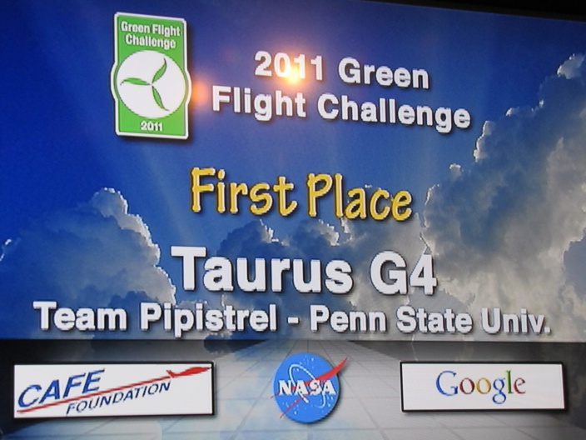
NASA Green Flight Challenge: Most efficient 4 seat plane
Goal: exceed 200 passenger miles per gallon
Design 4 seat electric plane
Team Pipistrel-USA’s winning 4 seat, electric-powered aircraft, the Taurus G4 flew 200 miles in 2 hours and achieved 403.5 passenger-MPG equivalent!
https://www.pipistrel-aircraft.com/10-years-ago-pipistrel-won-nasa/
https://www.nasa.gov/offices/oct/early_stage_innovation/centennial_challenges/general_aviation/

Slide 10
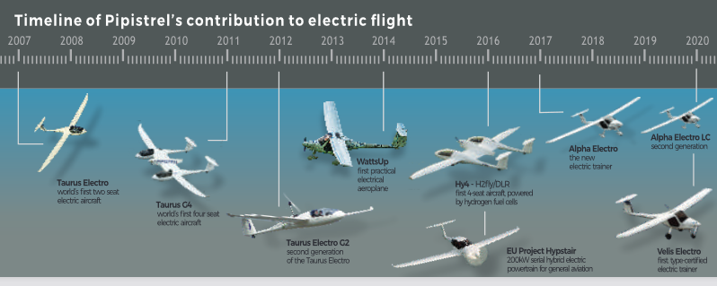
Timeline of Pipistrel’s contribution to electric flight

Slide 11
Pipistrel Alpha Electro
Fully electric ultralight aircraft
Dual battery configuration
Air cooled battery
60 kW electric motor weighs 20 kg
- more powerful than Rotax 912
Electric version of Alpha Trainer
Empty weight 368 kg
Maximum takeoff weight 550kg
https://uwaterloo.ca/sustainable-aeronautics/blog/wisa-looks-electric-aviation-canadas-first-pipistrel-alpha
https://www.pipistrel-aircraft.com/products/light-sport-microlight/alpha-electro/#tab-id-2

Slide 12
Industry Need: Flight School Renewal Opportunity
LOGO OF YOUR
AFFILATION
Source: TC Registry
Notes:
Of course the existing fleet needs to be replaced. Let’s do it with a low carbon solution instead of continuing the problem.

Slide 13
SURVEY RESULTS
LOGO OF YOUR
AFFILATION
Would you like to learn to fly an e-plane? (0-10 scale)
 | All | Student | Instructor | Manager | other
Type Certified
mean | 8.9 | 9.0 | 8.7 | 9.5 | 8.7
std dev | 2.1 | 2.2 | 2.2 | 1.0 | 1.7
n= | 180 | 113 | 34 | 15 | 18
Notes:
Very strong student response – even higher among managers

Slide 14
RESULTS: REASONS TO FL
LOGO OF YOUR
AFFILATION
Importance of reason to fly an e-plane? (0-10 scale)
 | All | Student | Instructor | Manager | Other
Cut emissions | 7.9 | 8.2 | 7.2 | 7.5 | 7.1
Reduce cost | 7.5 | 7.3 | 8.0 | 8.5 | 6.9
Future tech | 7.3 | 7.3 | 7.7 | 7.0 | 6.9
Quieter | 6.9 | 6.8 | 6.7 | 7.9 | 6.9
Safer | 6.0 | 5.8 | 6.0 | 7.4 | 6.1
Growing share | 5.6 | 5.7 | 5.7 | 5.6 | 4.5
Notes:
Recognise different motivations. Students want to cut emissions. Managers want to cut cost. Instructors want to fly future technologies. Yes quieter and safer are also on the managers minds.

Slide 16
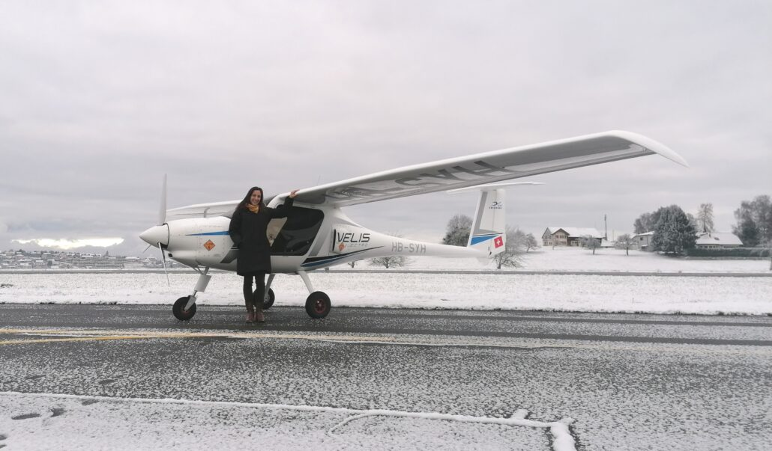
Swiss Success Story
MOTIVATION
LOGO OF YOUR
AFFILATION
Swiss early adopter 2020
Motivation: quiet performance
Noise complaints close flight operations on weekends
Quieter electric propulsion offered a solution
Timeline
July 2020 first Pipistrel Velis Electro delivered
AlpinAirPlanes GmbH and 10 partner flight schools
December 2021 1000 training hours accumulated
Top plane: HB-SYE approaching 300 hours
PPL student Ms Andrea Blindenbacker
“The experience is twofold for me. The ease of use of the Velis Electro allows you to fully concentrate on flying and really enjoying it, plus, knowing that your flights are at lower emissions and with less noise makes it even better.”
https://www.pipistrel-aircraft.com/the-swiss-go-swiiiishhhhh/
Notes:
Swiss pilot with the 1000th hour in their electric Evlis fleet. Nice snowy setting.

Slide 17
Case Study: Emissions
LOGO OF YOUR
AFFILATION
Emission reduction 50 kg CO₂ /hr
Student: 40 hrs of PPL training = 2 tonnes CO₂
Student: 200 hrs of CPL training = 10 tonnes CO₂
Manager: 1000 hrs/yr at flight centre = 50 tonnes CO₂ /yr per trainer replaced
Conventional trainer, Cessna 152, emits 51 kg CO₂ /hr
E-plane, Pipistrel Velis Electro, emits 1 kg CO₂/hr
Electricity used 20 kWh/hr * CO₂ intensity 0.06 kg CO₂ /kWh
Ontario low carbon electricity: nuclear, hydro, wind and solar
Solar hangar option 0.04 kg CO₂ /kWh
Image: https://www.icao.int/environmental-protection/Carbonoffset/Pages/default.aspx

