Slide 1
Electric Aircraft (Cont.) Presentation to KWRAA - January 2023

Slide 2
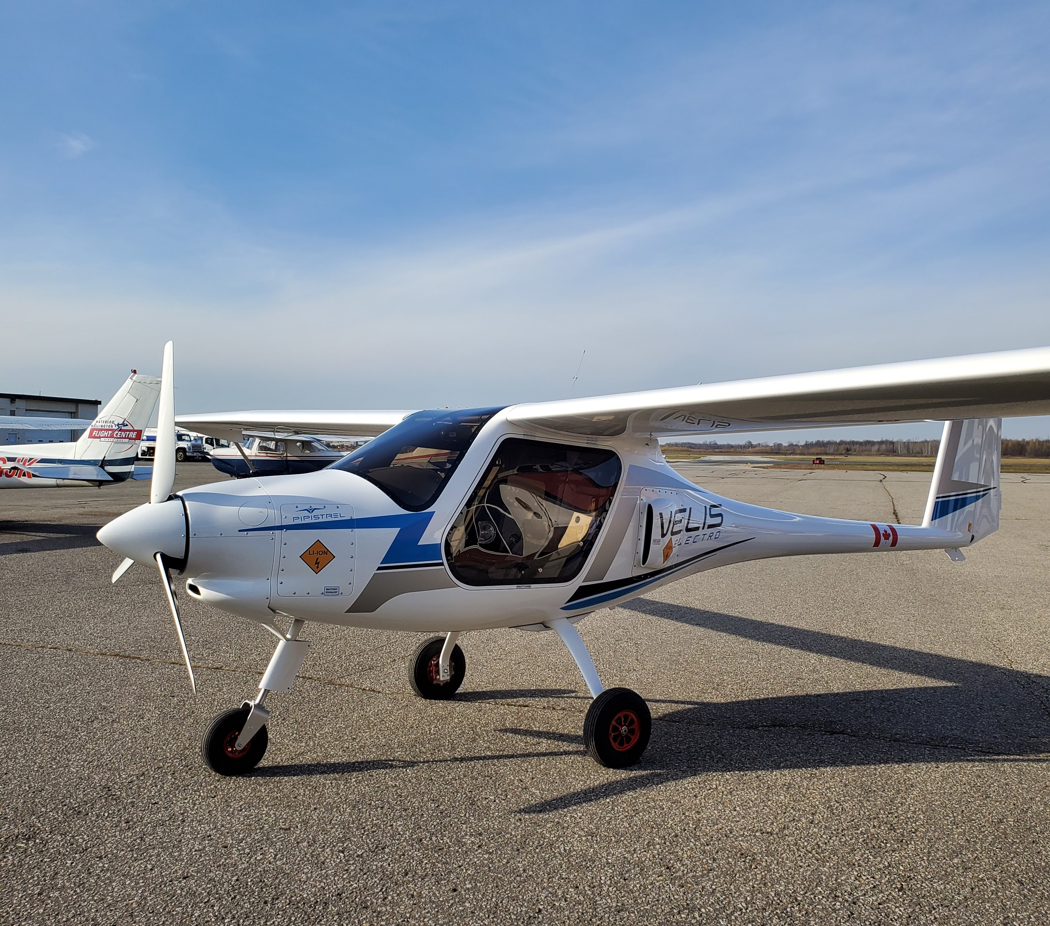
Next step: Velis Electro
Two seat trainer
What is different about it?

Slide 3
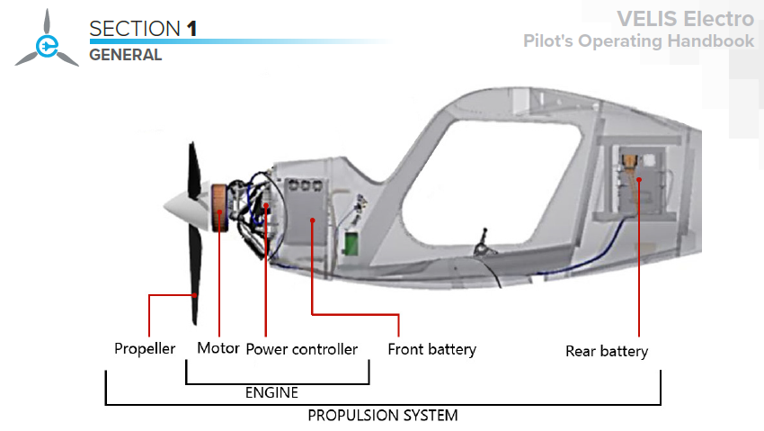
Propulsion system: Propeller, motor, controller, battery packs, controller. POH

Slide 4
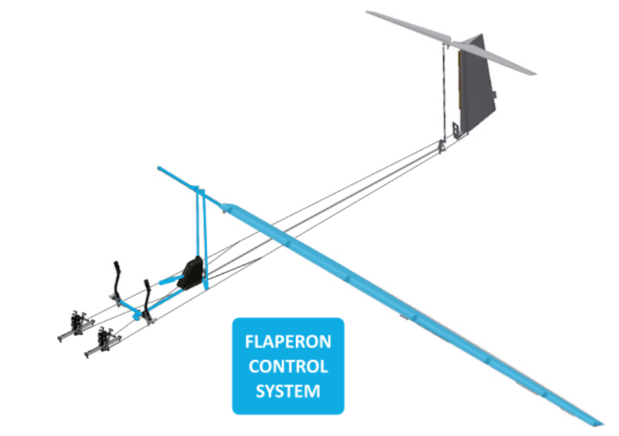
Flaperon = Flaps + Ailerons
Single control surface
Instead of two
Simple construction
Light weight
Source: https://www.pipistrel-online.com/mod/lesson/view.php?id=919&pageid=4362

Slide 5
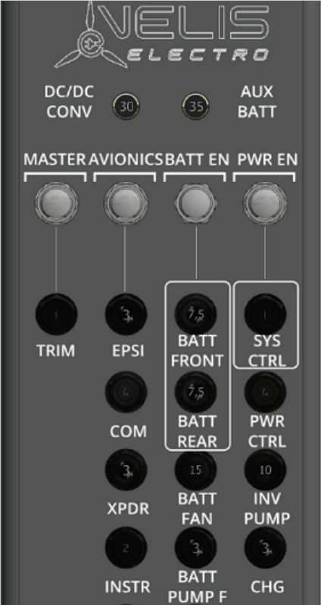
Velis electrical switches

Slide 6
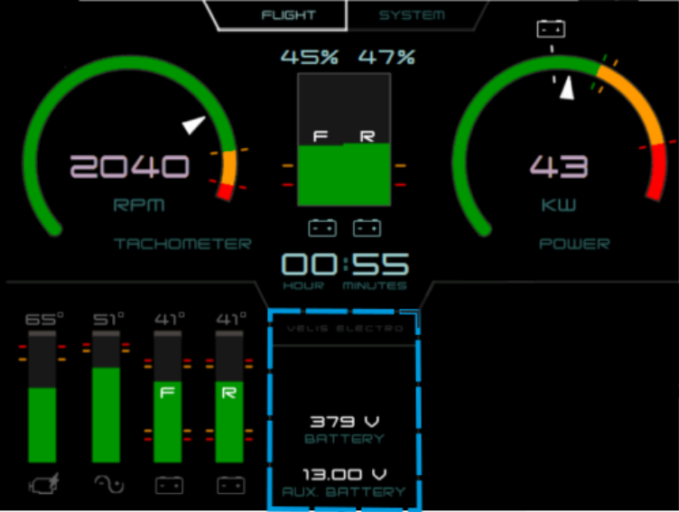
EPSI display
Electric Powerplant System Interface
Source: https://www.pipistrel-online.com/mod/lesson/view.php?id=919&pageid=4362

Slide 7
Electric Powered Xenos
Gabe DeVault’s electric powered Xenos (S/N X0059). [Courtesy: Xenos]
A former employee at Zero Motorcycles did some interesting tweaking to a Sonex Xenos. [Courtesy: Sonex]
https://www.flyingmag.com/a-better-way-to-fund-electric-aircraft-rd/

Slide 8
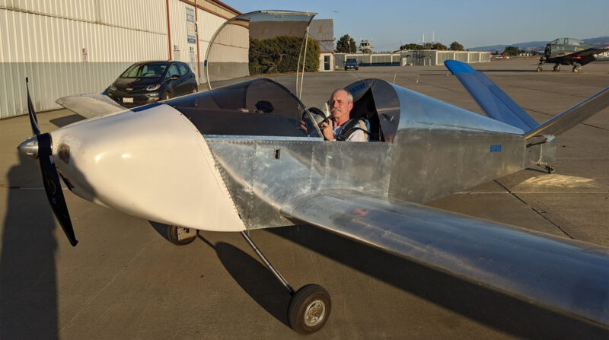
Engineer and E-plane
Gabe DeVault
Employee #1 at Zero Motorcycles (“Tesla of bikes”)
Installed powertrain in a Thunder Gull ultralight “eGull”
Zero Motorcycles upgraded system to 45 kW (60 hp)
He installed it in Sonex Xenos (personal project)
Now works for ZeroAvia (hydrogen fuel cells for e-planes)
Electric Xenos
100 hours experience
Can cruise for up to 90 minutes at 10 kW (better than Velis)
Cruises 98 mph at 24 kW no-reserve duration of 38 min.
Xenos quick-build kit US $53K power system US $20K ? + avionics

Slide 9
Snow Lake Lithium: Anatomy of the world’s first all-electric lithium Mine
https://newatlas.com/energy/snow-lake-lithium-mine/

Slide 10
Snow Lake Electric Lithium Mine Manitoba
https://newatlas.com/energy/snow-lake-lithium-mine/

Slide 11
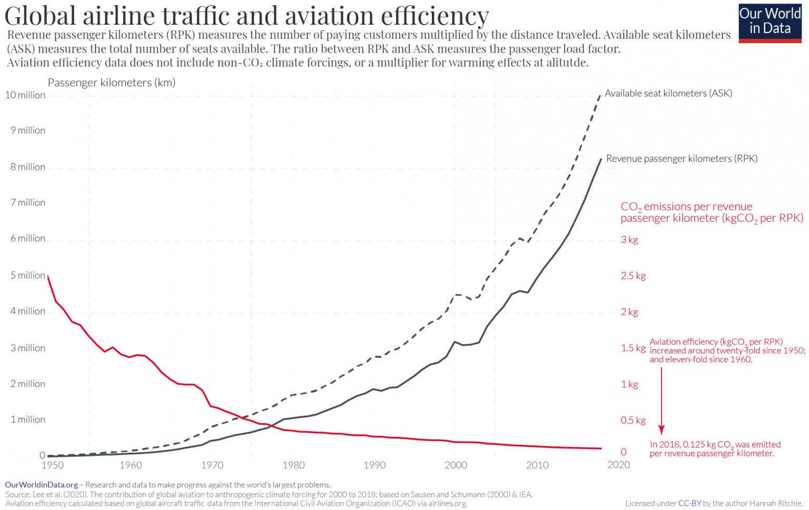
Conclusion
LOGO OF YOUR
AFFILATION
Many motivations / challenges
Solutions require diverse team: Sustainability, engineering, aviation
Future pathways
SAF
Hydrgen
Electric
Hybrid
Velis e-plane future
US aviation media: eplane “cool, but not for the US market”
Dutch flight school: >80% electric PPL time
Canada: ??
Source: Lee et al. 2021 https://ourworldindata.org/co2-emissions-from-aviation
Notes:
In conclusion. We are at a transition point. Many challenges and possible solutions.
One solution the eplane for flight training (Velis Electro) has been certified in Europe. Prominent US aviation media say it is not for the US market. Dutch and German flight schools say they can do over 80% of flight training electrically. Where will Canada go?

Slide 15
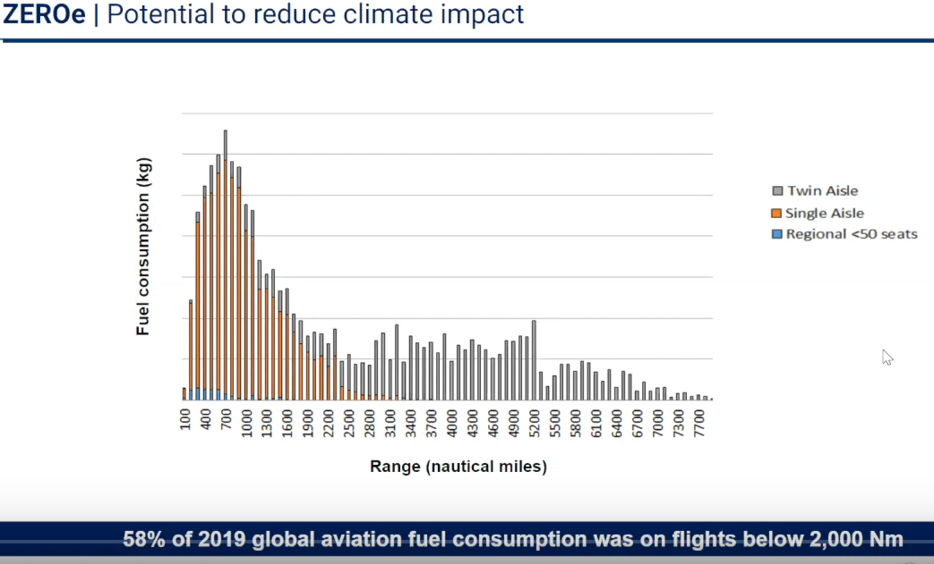
ZEROe Airbus

Slide 16
RESULTS: KNOWLEDGE
LOGO OF YOUR
AFFILATION
Table: Average knowledge of e-planes by group (0-10 scale)
 | All | Student | Instructor | Manager | other
General
mean | 3.7 | 3.3 | 4.0 | 4.7 | 5.0
std dev | 2.8 | 2.6 | 2.6 | 3.7 | 2.9
Training
mean | 3.1 | 2.7 | 3.6 | 4.1 | 3.7
std dev | 2.7 | 2.5 | 2.7 | 3.5 | 2.8
Table 1. Sample results of study
Parameter | Value 1 | Value 2
X | 0 | 4
Y | 1 | 5
Z | 2 | 6
W | 3 | 7
Notes:
Low knowledge levels recognized.

Slide 17
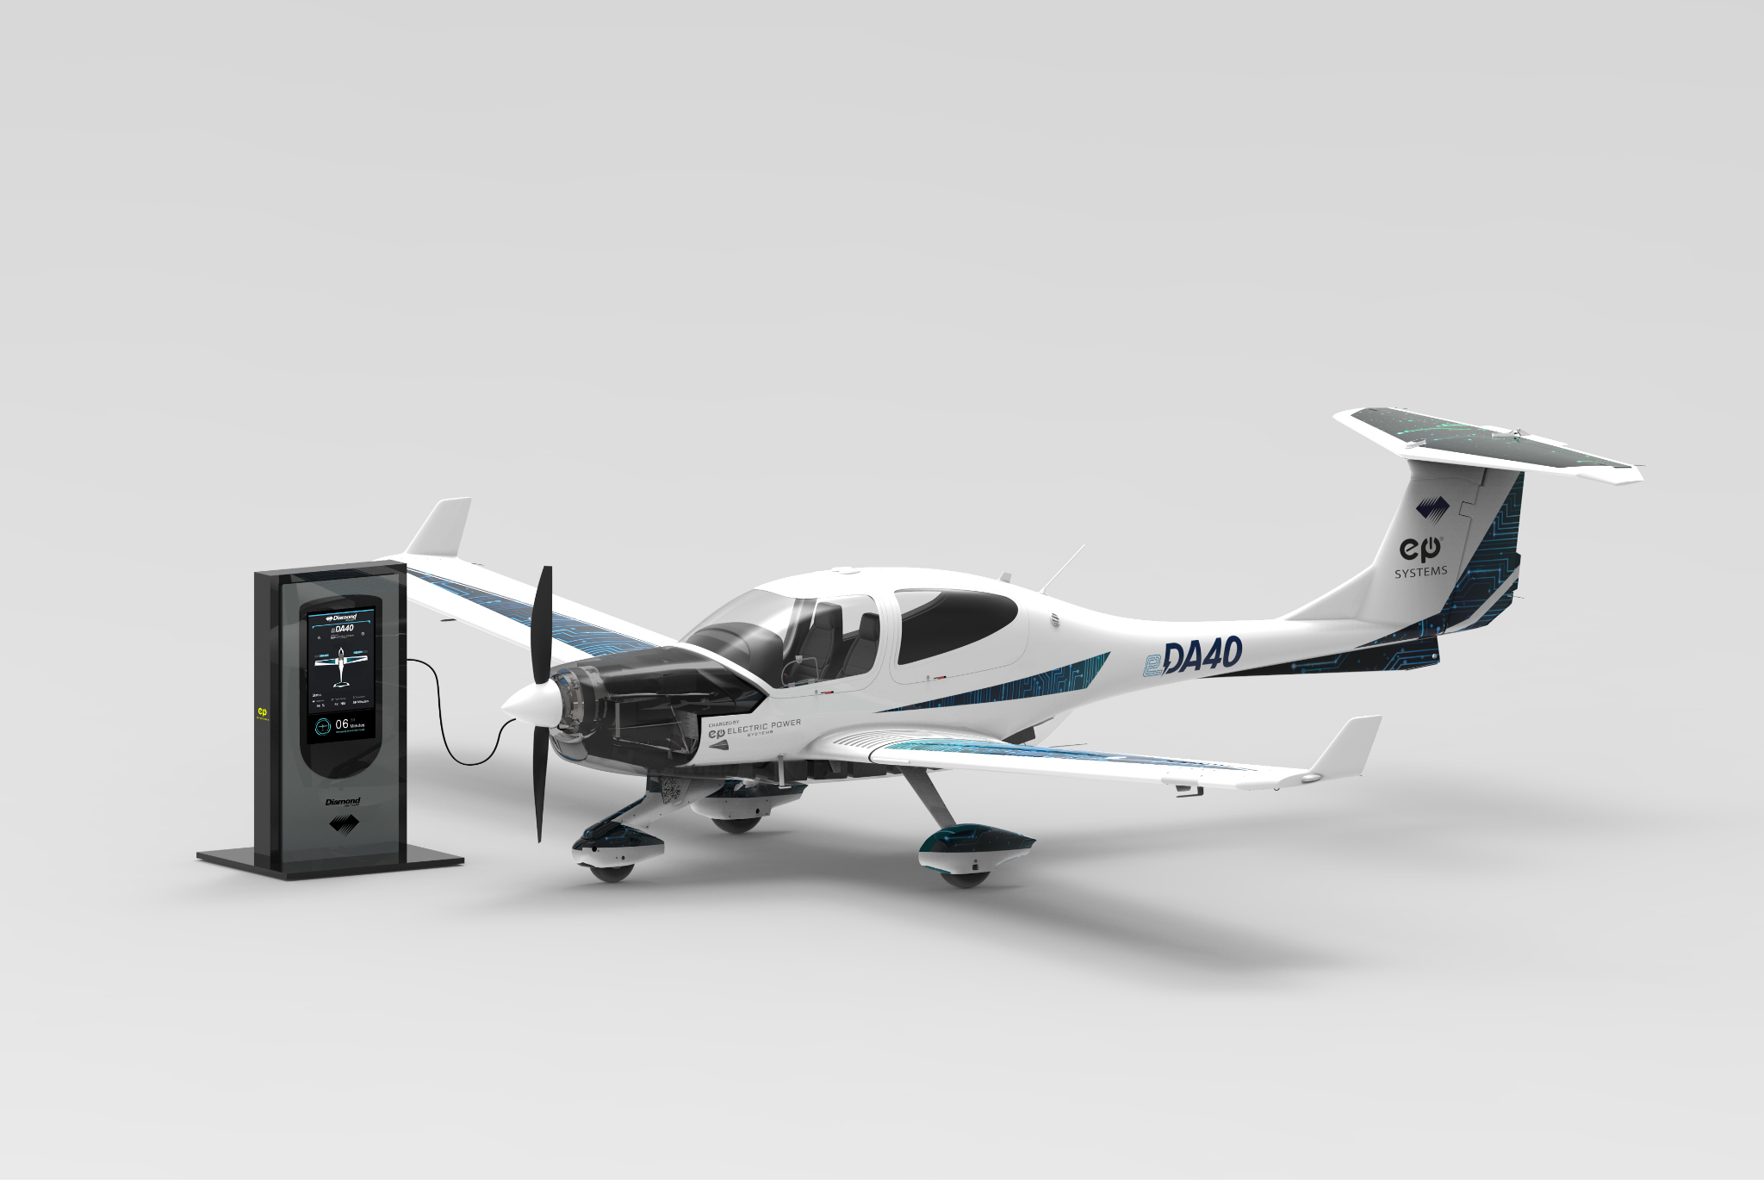
Next Generation Perception
Sustainable Aviation “a lot of talk…insufficient tangible action” team all under 30
“We find ourselves in the beginning of a transition period where GA flying will be one of the first sectors of aviation where part of the operations can be flown on aircraft producing close to zero emissions.” Matthias Niederhauser and Robin Wenger https://www.diamondaircraft.com/en/about-diamond/newsroom/diamonddiary/article/diamondo-earthrounding-in-a-da50-rg-mission-accomplished/
Communication projects:
Diamondo Earthrounding flight with Waterloo/WISA stop
Connecting initiatives: efficient aircraft, carbon calculator, SAF purchase local or central creates demand today, solar pv for fuel processing, CCS, research (WISA)
Notes:
My focus is just on the first line. Young aviators want sustainability action not just talk

